Slide 1

CUSTOMER RETENTION PROJECT
Submitted by
Aaluri Krishnaveni Reddy

Slide 2
Business Problems
1.using gender column we can see which gender persons are purchasing online more?
2.which age group people are using more?
3.which city is trading online more?
4.as per pincode which city people using more online shops
5.checking the people how long they are shopping in online
6.check the people how many times they order in last one year?
7.how the people access the internet while shopping online?
8.which device do you access to do shopping in online more?
9. screen size of mobiles using more
10.which os type people using more to reach the online shopping
11.which browser is using more to do online shopping by the customers
12.channels that customers arrive at their favorite onine store for the first time and how do you reach for next time
13.how long customer takes time to decide about purchasing products in online
14.how many payment options we have and which is the best option to pay and customers are using which type of payments mode more
15.checking the cancel frequency and cancellation reasons
16.how customer think that content is easy to read and understand or not
17. sites are giving similar product information
18. is it important to know more about product seller pr not
19. sites are giving full relevant information on listed products, is it stated clearly or not
20.can we easily navigate in website or not, loading and processing speed of website, and is it user friendly interface of web site or not

Slide 3
Customer satisfaction has emerged as one of the most important factors that guarantee the success of online store it has been posited as a key stimulant of purchase, repurchase intentions and customer loyalty. A comprehensive review of the literature, theories and models have been carried out to propose the models for customer activation and customer retention. Five major factors that contributed to the success of an e-commerce store have been identified as: service quality, system quality, information quality, trust and net benefit.
Introduction

Slide 4
21.trust fulfilment of customer, customer support response, customer privay guarantee
22.how the website responses and availability of sevaral communication channels
23.benefits,convineince and enjoyment of online shopping
24.return replacemnet policies of the e-tailer is important for purchase decision
25.checking the loyality of programs access
26. displaying quality infomration, good quality of satisfation and net benfits by the websites, is it satisfies the customers are not
27.trusting websites
28.how they categories products, relevant product infomation
29. monetary saving, money worthy
30.the convenience of patronzing the online retailer
31.shopping on the website gives you the sense of advanture
32.social status, gratification
33.role fulfilment
34.shopped from how many sites
35. how easy to use web application
36. visually appealing webapp
37.how e-retailer makes wild variety of product on offer

Slide 5
38.customer think which website gives complete product information
39.which is the fast loading website and application
40.which is the most reliable website or application
41.customer think which is the quickness to compelte purchase
42.which website or application gives more payment options and which gives limited payment methods
43.which is the best website or application in speedy order delivery and which gives late delivery
44.which is giving best privacy of customer information and financial information security to the customer
45.which is the trust worthy website or application that customer suugesting
46.which gives multi channel assistance more
47.which takes longer time to get logged in and loger time in displaying graphics and photos about sales period and promotions
48.which gives late declaration of price and longer page loading time
49.which websites or applications changes there designs well
50.frequent distruption of page
51.website efficiency
52.which is the best online retailer would you recommended by the customer

Slide 6
Basic steps to start analysis
Importing libraries
Loading the data
Check the data distribution in the loaded data
Check the dimension of the dataframe
Check the null values
Check the info().
Check the dtypes and check the data columns
Here I change the column names
Start data visualization
Observations after we check the data visualization

Slide 7
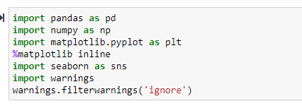
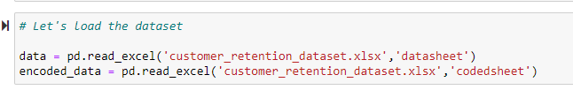
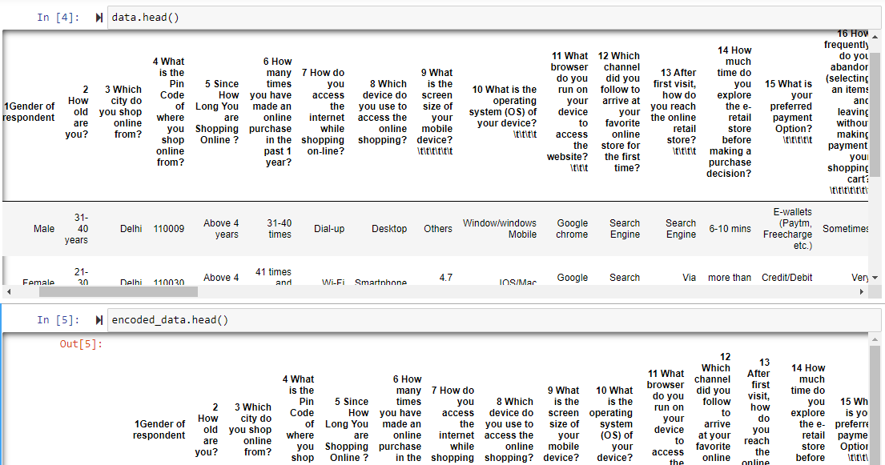
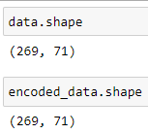
Importing libraries, loading the data , checking the dimension of dataframes and checking the data distributed in the datafame by using head() function

Slide 8
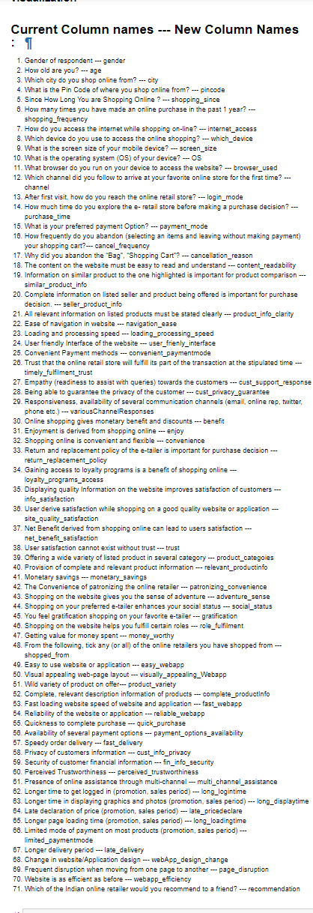
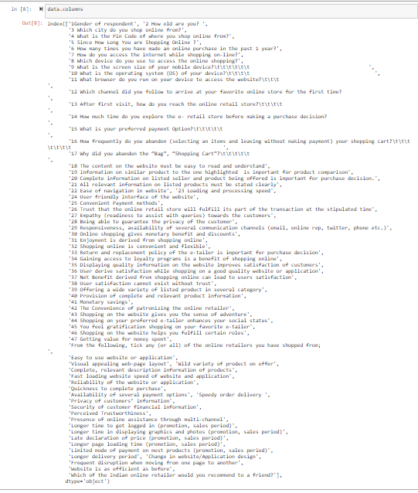
Checking the data columns and renaming the columns with simple names

Slide 9
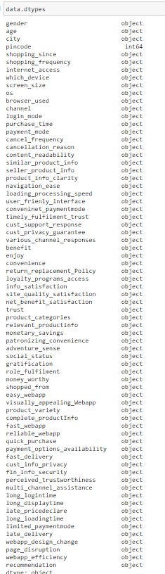
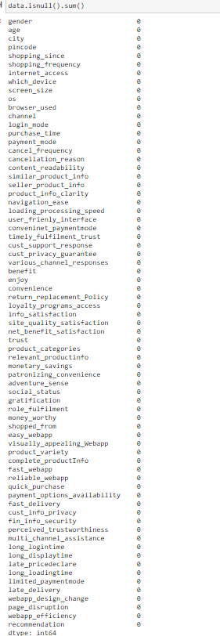
Checking dtypes and checking null values

Slide 10
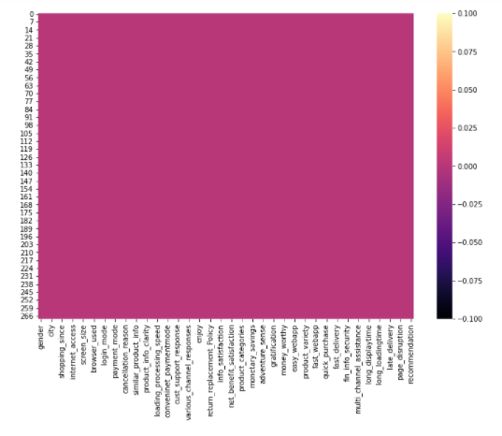
Heatmap to check the null values

Slide 11
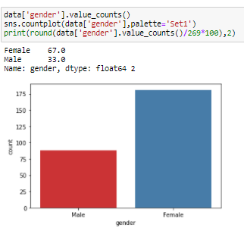
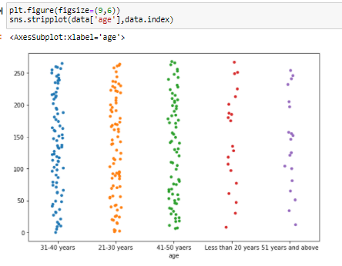
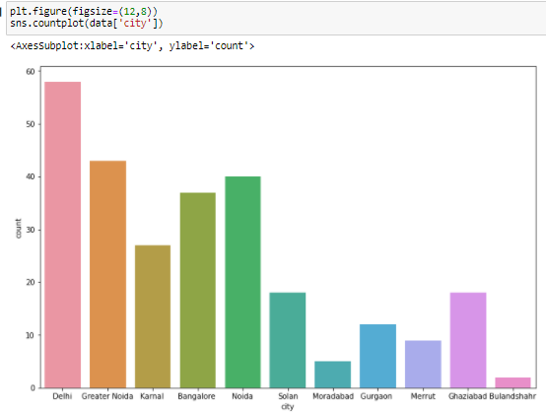
Data visualization

Slide 12
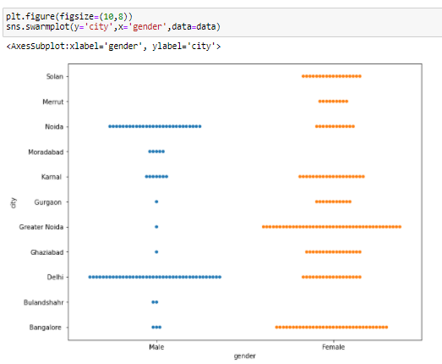
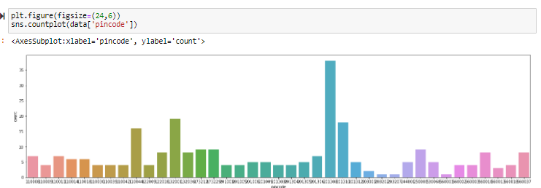
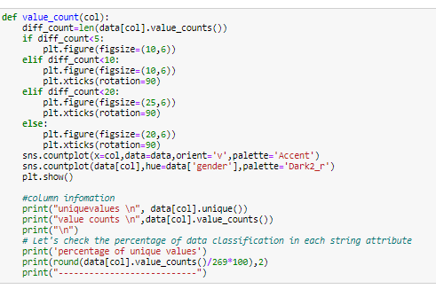

Slide 13
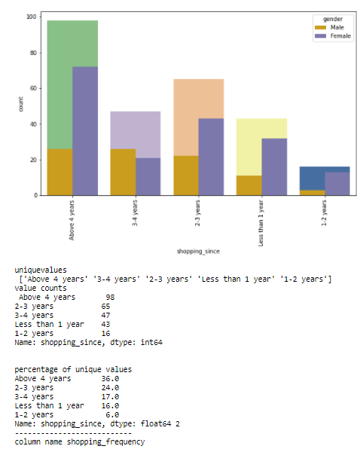
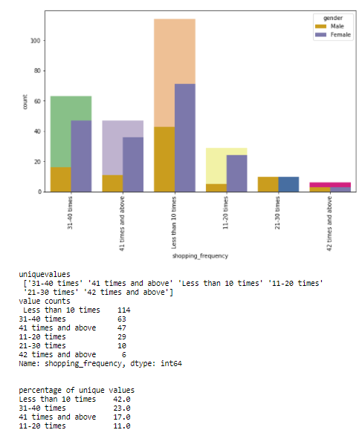
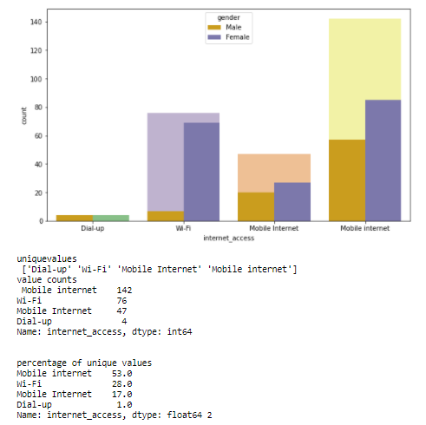
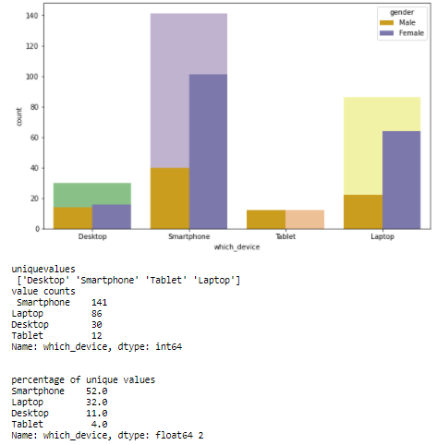
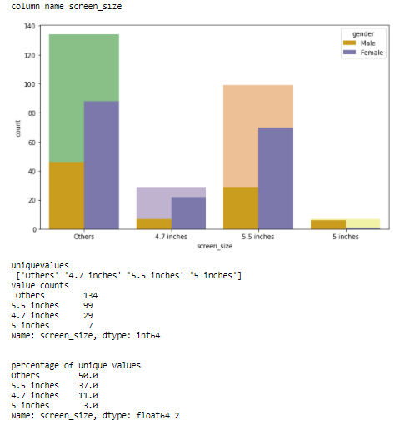
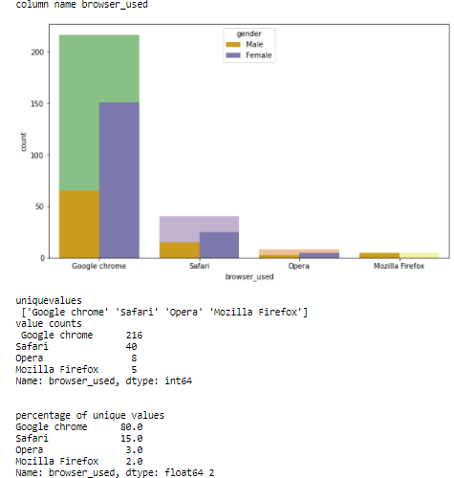
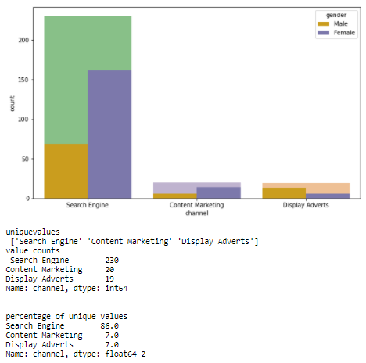
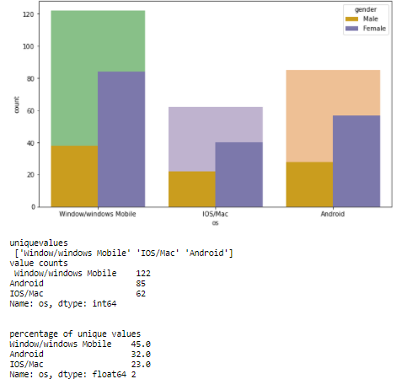

Slide 14
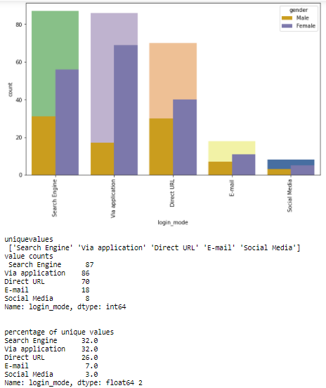
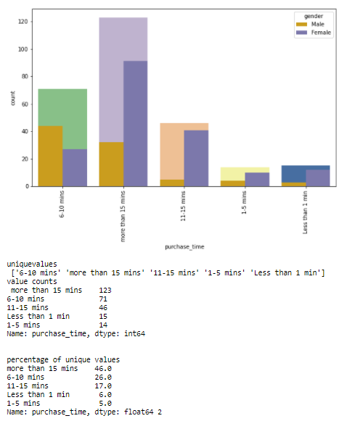
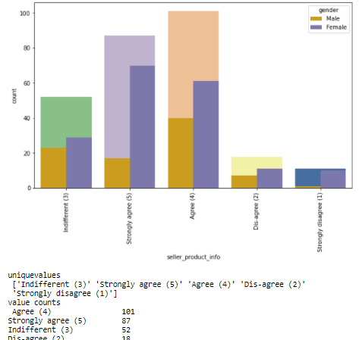
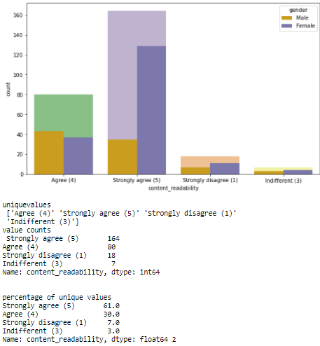
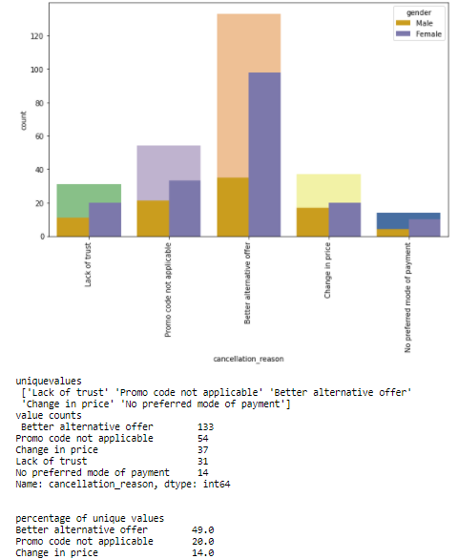
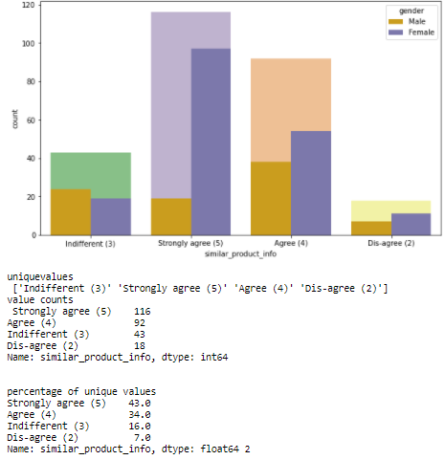
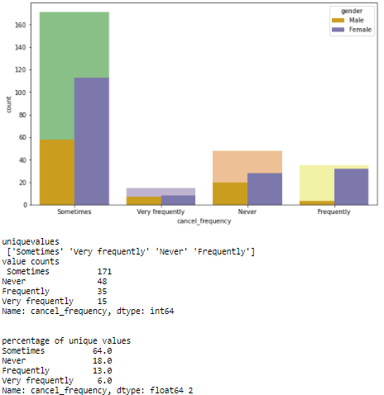
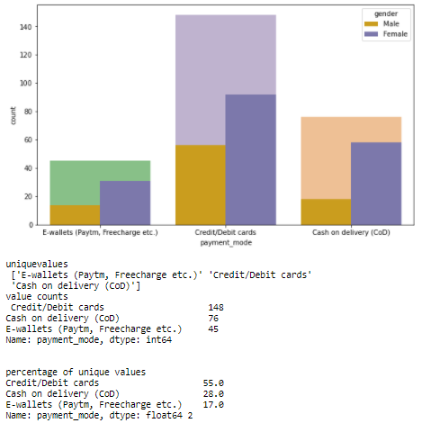

Slide 15
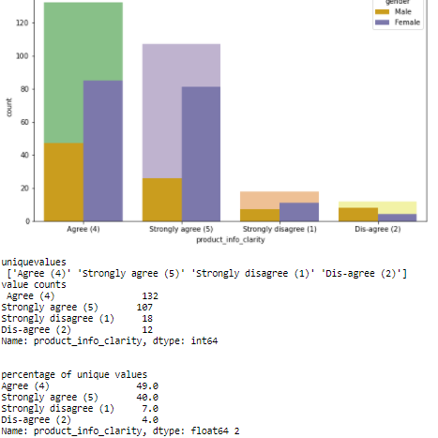
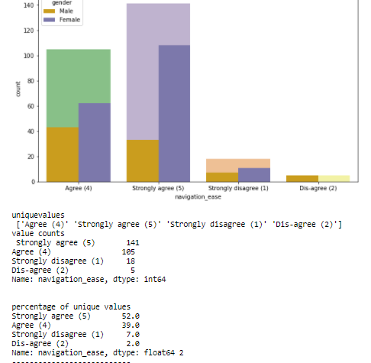
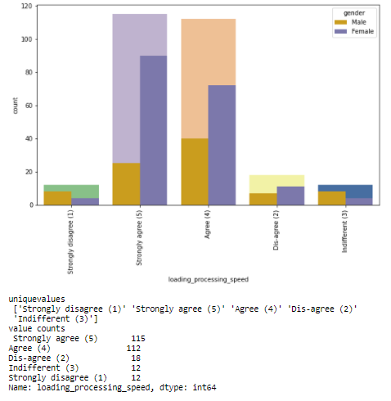
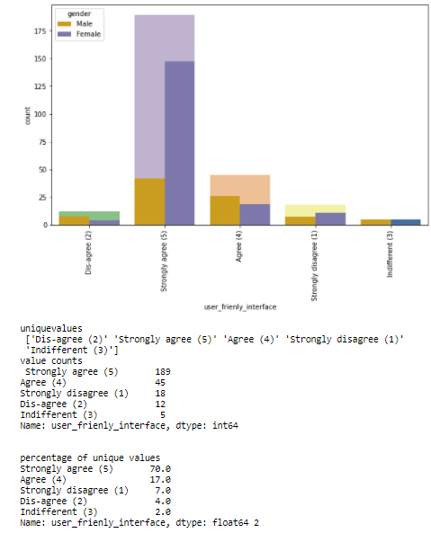
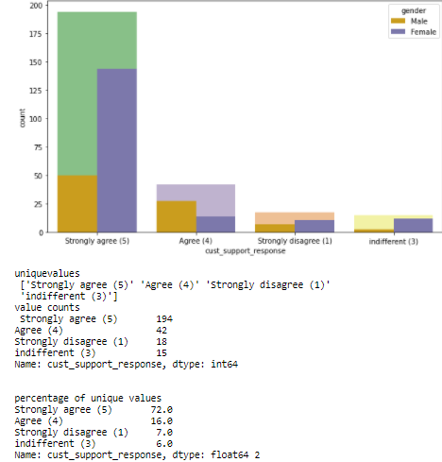
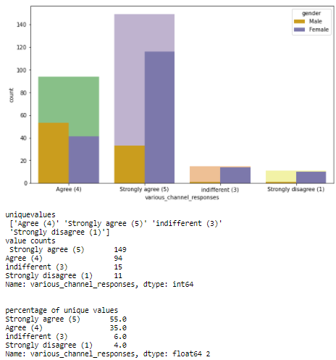
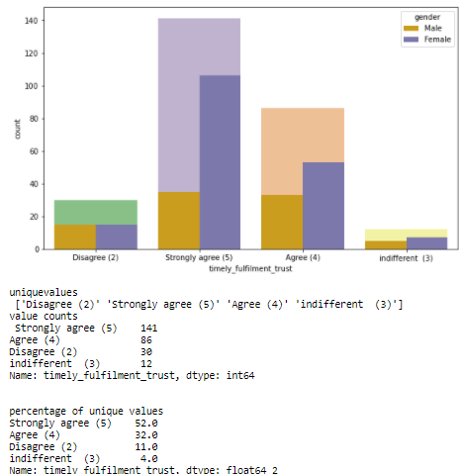
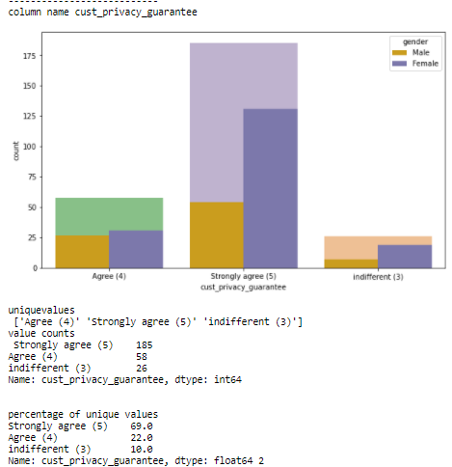

Slide 16
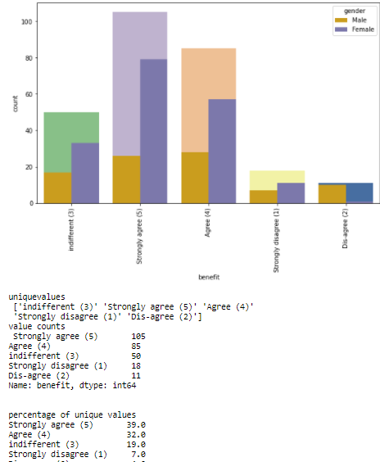
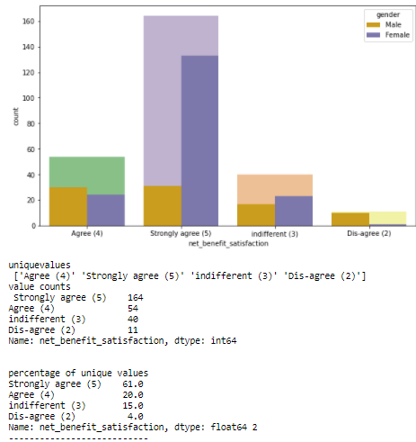
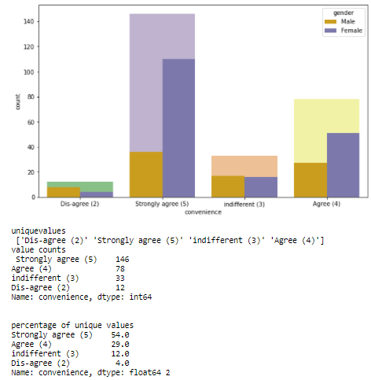
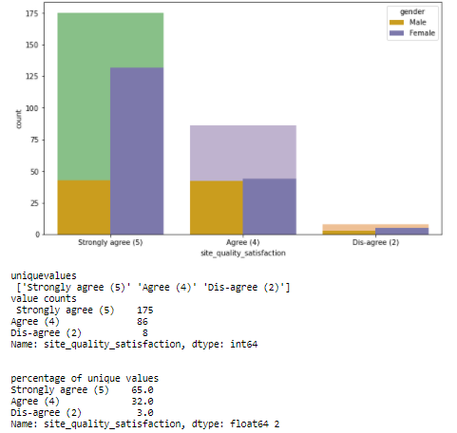
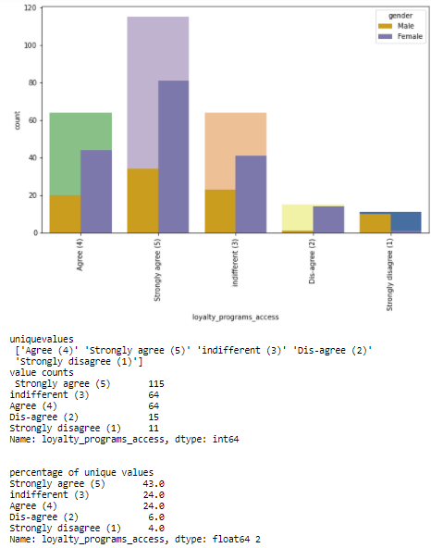
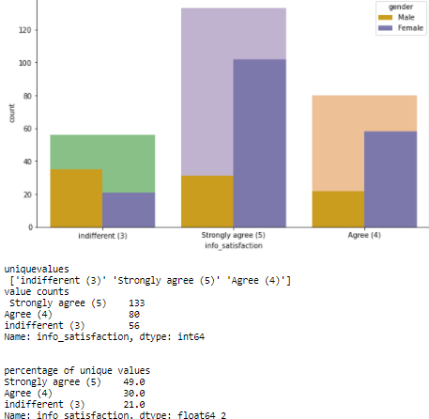
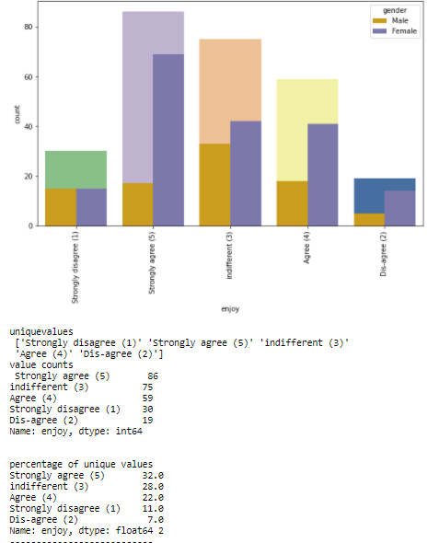
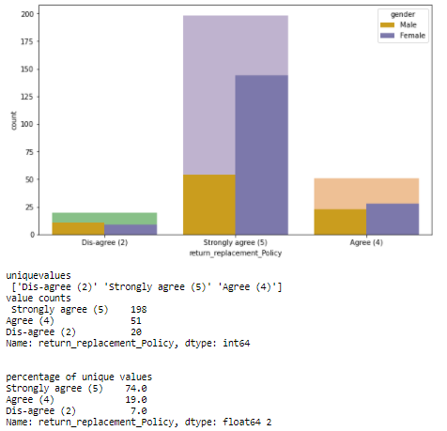

Slide 17
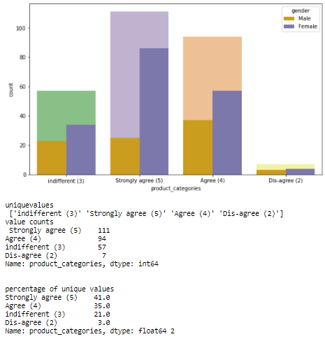
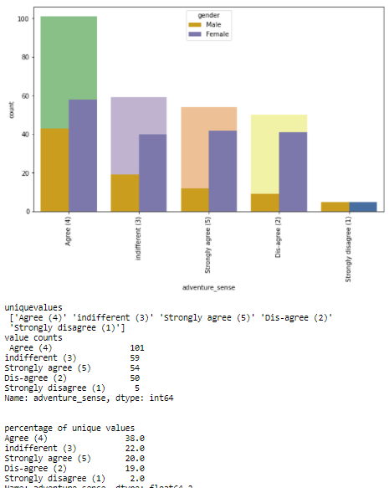
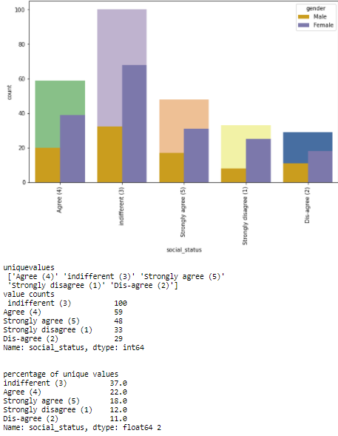






Slide 18






Slide 19






Slide 20









Slide 21









Slide 22
Observation from all above plots
Here in given data most of the customers are female, we have 67% of female customers
Customers between 20 to 50 years shopped more from the online store. 86 % of customers are between 20 to 50
Delhi, Bangalore, Noida are the cities with high number of buyers
36% customers were found shopping online for more than 4 years , 24% were shopping for 2-3 years
IN last one year 42% customers have purchased online less than 10 times,23% customers purchased 31-40 times only 2 percent customers purchased more than 42 times
70% customers used mobile internet for online purchase and 1% of customer using dial-up
52% customers used Smartphone for online purchase, 32% used laptop , 11% of customers using desktop and least 4% used tablet
37% of customers used 5.5 inches screen sized moniles, 11% customers are using 4.7 inches screen, and only 3% of people using 5 inches, remaining customer are using either bigger size screen aor smaller size screen
45% customers use Windows phone
80% customers using Google chrome to browser their favorite website
86% customers uses Search engine to reach their favorite online store
After first visit 32 % customers used search engine to reach online store again and 32% uses application. We can assume that these customers have been retained by the E commerce website as they have downloaded the application on their phone and have a fair chance of shopping again.
46% customers takes more than 15 minutes before making a purchase, 26% take 6-10 minutes only
55% customers prefer Credit/Debit cards to make payments ,28% preferred COD and 17 % preferred Wallets
64% customers abandon their shopping cart sometimes, 19% abandon their cart frequently, and 18% of customer are never abandon their shopping cart

Slide 23
49% customers abandon their bag due to better alternative offer, 20% abandon due to promo code not applicable
61% customers have strongly agreed and 30% customers are agreed to have easy website content which is easy to understand
43% customers agreed strongly and 34% are agreed that Information on similar product to the one highlighted is important for product comparison.
70% customers agree that Complete information on listed seller and product being offered is important for purchase decision
90% customers agree all relevant information on listed products must be stated clearly.
90% customers agreed that the website should be easily navigable
85% customers had no issues with the loading and processing speed
87% customers agree with user friendly website interface.
59% customers strongly agree with the convenient paying methods.
52% customers trust that online store will fulfill its part of transaction at stipulated time
88% customers like the organization's readiness to assist with queries
69% strongly agreed that webpages/application giving privacy
Responsiveness, availability of several communication channels (email, online rep, twitter, phone etc.): 90% customers agreed to it.
54% customers enjoys online shopping
84% customers agree that online shopping is convenient and flexible
90% customers agree that return and replacement policy helps them making purchase decision.
55% customers agree that gaining access to loyalty program is a benefit of shopping online
Displaying quality Information on the website improves satisfaction of customers: 80% customer agreed to it.
95% customers are satisfied while shopping on a good quality website

Slide 24
Net Benefit derived from shopping online can lead to users satisfaction:90% customers agreed
User satisfaction cannot exist without trust: 85% customers agree that customer satisfaction cannot be built without trust.
Offering a wide variety of listed product in several categories: 75% customer agreed.
86% customers like to have complete and relevant information
50% agree that online shopping gives monetary benefit and discounts to the customer:
80% customers agree to receive monetary savings while shopping online
70% agree with the convenience of patronizing the online retailer
58% customers agree that online shopping give the sense of adventure
only 40% customers agree that online shopping enhances their social status
45% customers feel gratified while shopping with their favorite retailer
45% customers feel that shopping online helps them fulfill certain roles and 33% customers are chose indifferent
85% customers agree they get value for their money while shopping online

Slide 25
Maximum people have shopped from these 5 companies - Amazon.in, Flipkart.com, Paytm.com, Myntra.com, and Snapdeal.com.
97% customer are think that amazon.in is easy to access the page, 75% of flipkart.com
48% customers says flipkart.com, amazon.in shows wide variety of products
37% customers like flipkart.com and amazon.in in terms of displaying complete and relevant information of the products
In terms of speed Amazon.in is liked by 90% customers , 60 % like Flipkart.com , 27% Myntra.com
78% customers trust Amazon.in to be reliable , 55% likes flipkart.com , 25% Myntra.com
80% customers likes Amazon.in quickness to complete the purchase , 60% likes Flipkart.com, 30% likes Myntra.com
80% customers likes Amazon.in is giving more payment options , 68% likes flipkar.com
89% likes Amazon.in fast delivery , 60% likes Flipkart.com , 11% likes Myntra.com , 18% likes Snapdeal.com
82% customers trust amazon.in in terms of keeping the privacy of customer information, 56% trust flipkart 20% trust Myntra , 17 % trust Snapdeal
76 % customers trust amazon.in that their financial information secured, 55% Flipakrt.com, 34% Myntra.com , 37% Snapdeal.com , 33% Paytm.com
84% customers believe Amazon.in perceived trustworthiness, 43% - Flipkart.com , 33% - Myntra.com , 27% Snapdeal.com
86% customers like Amazon.in in terms of online assistance through multi-channel , 51% -Flipkart.com ,42% Myntra.com
50% customers agree that Amazon.in takes longer time to log them in while in sales period/promotions , 39% goes with flipkart.com, 29% goes with paytm.com, 13% goes with Myntra.com , 16% Snapdeal.com
46% customers says that amazon.in takes longer time in displaying photos in sales/promotion , 35%- flipkart.com, 34% Snapdeal.com, 27% Myntra.com, 11% Paytm.com
In late declaration of price in promotion/sales 28% goes with Myntra.com, 21% amazon.in , 16% flipkart.com , 18% Snapdeal.com, 23% Paytm.com

Slide 26
Longer page loading in promotion 26% customer goes with Myntra.com, 23% flipkart.com, 23% amazon.in, 24% Snapdeal.com
limited mode of payment on most products during sales promotions 41% goes with Snapdeal.com, 40% -amazon.in, 23% flipkart.com, 20% Paytm .com and only 3% Myntra.com
Time taken in product delivery Paytm.com has highest votes of 37%, Snapdeal.com, flipkart.com 16%, amazon.in, 24% and Myntra 10%. Hence Snapdeal and Myntra take minimum time for delivery among all.
customers like the changes in website/application design, 53% customers likes amazon.in and 27% in Flipkar.com
29% customers dislikes disruptions while moving to another page on amazon.in, 24% on Myntra.com, 27% Snapdeal.com, 14% Paytm.com, 23% Snapdeal.com
68% customers says that amazon.in website is as efficient as before, 43% for flipkart.com, 22% for Paytm.com, 9% for Snapdeal.com
81% customers would like to recommend amazon.in to a friend, 47% would like flipkart.com , 28% would like for Myntra.com , 16% for Paytm.com and least 4 % would like to recommend Snapdeal.com
Thank you

